Slide 1


FOUNDATIONS OF INDIVIDUAL BEHAVIOUR
UNIT 10

Slide 2
LEARNING OUTCOME
Identify the focus and goals of individual behavior within organizations.
Explain the role that attitudes play in job performance.
Describe different personality theories.
Describe perception and factors that influence it.
Discuss learning theories and their relevance in shaping behavior.
Discuss contemporary issues in organizational behavior.

Slide 3
FOCUS AND GOALS OF ORGANIZATIONAL BEHAVIOR
Behavior - the actions of people.
Organizational behavior - the study of the actions of people at work.
Notes:
Managers need good people skills. The material in this and the next three chapters draws heavily on the field of study that’s known as organizational behavior (OB). Although it’s concerned with the subject of behavior—that is, the actions of people— organizational behavior is the study of the actions of people at work.

Slide 4
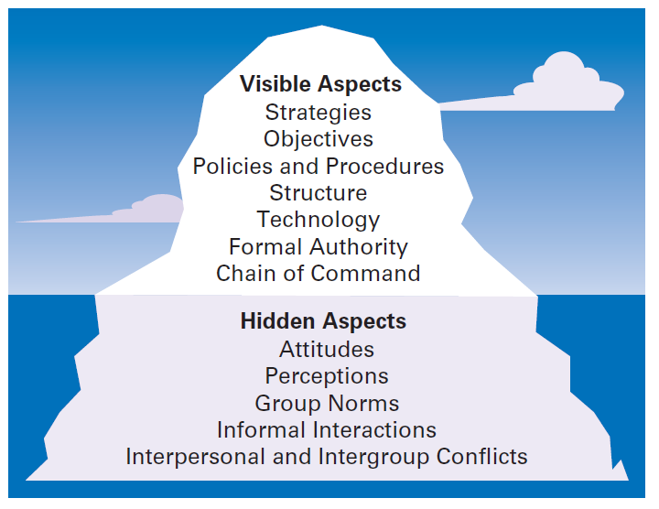
EXHIBIT 15-1 ORGANIZATION AS ICEBERG
Notes:
One of the challenges in understanding organizational behavior is that it addresses issues that aren’t obvious. Like an iceberg, OB has a small visible dimension and a much larger hidden portion. (See Exhibit 15-1.)

Slide 5
FOCUS OF ORGANIZATIONAL BEHAVIOR
Organizational behavior focuses on three major areas
Individual behavior including attitudes, personality, perception, learning, and motivation.
Group behavior including norms, roles, team building, leadership, and conflict.
Organizational aspects including structure, culture, and human resource policies and practices
Notes:
Organizational behavior focuses on three major areas. First, OB looks at individual behavior. Based predominantly on contributions from psychologists, this area includes such topics as attitudes, personality, perception, learning, and motivation. Second, OB is concerned with group behavior, which includes norms, roles, team building, leadership, and conflict. Our knowledge about groups comes basically
from the work of sociologists and social psychologists. Finally, OB also looks at organizational aspects including structure, culture, and human resource policies and practices. We’ve addressed group and organizational aspects in previous chapters. In this chapter, we’ll look at individual behavior.

Slide 6
GOALS OF ORGANIZATIONAL BEHAVIOR
The goals of OB are to explain, predict, and influence behaviors such as
Employee productivity - a performance measure of both efficiency and effectiveness.
Absenteeism - the failure to show up for work.
Turnover - the voluntary and involuntary permanent withdrawal from an organization
Notes:
The goals of OB are to explain, predict, and influence behavior. Managers need to be able to explain why employees engage in some behaviors rather than others, predict how employees will respond to various actions and decisions, and influence how employees behave.
What employee behaviors are we specifically concerned with explaining, predicting, and influencing? Six important ones have been identified: employee productivity, absenteeism, turnover, organizational citizenship behavior (OCB), job satisfaction, and workplace misbehavior. Employee productivity is a performance measure of both efficiency and effectiveness. Managers want to know what factors will influence
the efficiency and effectiveness of employees. Absenteeism is the failure to show up for work. It’s difficult for work to get done if employees don’t show up. Turnover is the voluntary and involuntary permanent withdrawal from an organization. It can be a problem because of increased recruiting, selection, and training costs and work disruptions.

Slide 7
GOALS OF ORGANIZATIONAL BEHAVIOR (CONT.)
Organizational Citizenship Behavior (OCB) - discretionary behavior that is not part of an employee’s formal job requirements, but which promotes the effective functioning of the organization.
Job satisfaction - an employee’s general attitude toward his or her job
Notes:
Organizational citizenship behavior (OCB) is discretionary behavior that’s not part of an employee’s formal job requirements but promotes the effective functioning of the organization.
Job satisfaction refers to an employee’s general attitude toward his or her job. Although job satisfaction is an attitude rather than a behavior, it’s an outcome that concerns many managers because satisfied employees are more likely to show up for work, have higher levels of performance, and stay with an organization.

Slide 8
GOALS OF ORGANIZATIONAL BEHAVIOR (CONT.)
Workplace misbehavior - any intentional employee behavior that is potentially damaging to the organization or to individuals within the organization
Notes:
Workplace misbehavior is any intentional employee behavior that is potentially harmful to the organization or individuals within the organization. Workplace misbehavior shows up in organizations in four ways: deviance, aggression, antisocial behavior, and violence. Such behaviors can range from playing loud music just to irritate coworkers to verbal aggression to sabotaging work, all of which can create
havoc in any organization.

Slide 9
ATTITUDES AND JOB PERFORMANCE
Attitudes - evaluative statements, either favorable or unfavorable, concerning objects, people, or events.
An attitude is made up of three components: cognition, affect, and behavior
Notes:
Attitudes are evaluative statements—favorable or unfavorable—concerning objects, people, or events. They reflect how an individual feels about something. When a person says, “I like my job,” he or she is expressing an attitude about work. An attitude is made up of three components: cognition, affect, and behavior.

Slide 10
ATTITUDES AND JOB PERFORMANCE (CONT.)
Cognitive component - that part of an attitude that’s made up of the beliefs, opinions, knowledge, or information held by a person.
Affective component - that part of an attitude that’s the emotional or feeling part.
Behavioral component - that part of an attitude that refers to an intention to behave in a certain way toward someone or something.
Notes:
The cognitive component of an attitude refers to the beliefs, opinions, knowledge, or information held by a person (for instance, the belief that “discrimination is wrong”). The affective component of an attitude is the emotional or feeling part of an attitude. Using our example, this component would be reflected by the statement, “I don’t like Pat because he discriminates against minorities.” Finally, affect can lead
to behavioral outcomes. The behavioral component of an attitude refers to an intention to behave in a certain way toward someone or something.

Slide 11
JOB SATISFACTION
A person with a high level of job satisfaction has a positive attitude toward his or her job.
A person who is dissatisfied has a negative attitude.
Job satisfaction is linked to productivity, absenteeism, turnover, customer satisfaction, OCB, and workplace misbehavior
Notes:
A person with a high level of job satisfaction has a positive attitude toward his or her job. A person who is dissatisfied has a negative
attitude. When people speak of employee attitudes, they usually are referring to job satisfaction.

Slide 12
JOB INVOLVEMENT AND ORGANIZATIONAL COMMITMENT
Job involvement - the degree to which an employee identifies with his or her job, actively participates in it, and considers his or her job performance to be important to self-worth.
Organizational commitment - the degree to which an employee identifies with a particular organization and its goals and wishes to maintain membership in that organization.
Notes:
Job involvement is the degree to which an employee identifies with his or her job, actively participates in it, and considers his or her job performance to be important to his or her self-worth. Employees with a high level of job involvement strongly identify with and really care about the kind of work they do. Their positive attitude leads them to contribute in positive ways to their work.
Organizational commitment is the degree to which an employee identifies with a particular organization and its goals and wishes to maintain membership in that organization. Whereas job involvement is identifying with your job, organizational commitment is identifying with your employing organization.

Slide 13
JOB INVOLVEMENT AND ORGANIZATIONAL COMMITMENT (CONT.)
Perceived organizational support - employees’ general belief that their organization values their contribution and cares about their well-being.
Notes:
Although the commitment of an employee to an organization may not be as important as it once was, research about perceived
organizational support—employees’ general belief that their organization values their contribution and cares about their well-being—shows that the commitment of the organization to the employee can be beneficial. High levels of perceived organizational support lead to increased job satisfaction and lower turnover.

Slide 14

EMPLOYEE ENGAGEMENT
Employee engagement - when employees are connected to, satisfied with, and enthusiastic about their jobs.
Notes:
Managers want their employees to be connected to, satisfied with, and enthusiastic about their jobs. This concept is known as employee engagement. Highly engaged employees are passionate about and deeply connected to their work. Disengaged employees have essentially “checked out” and don’t care. They show up for work, but have no energy or passion for it.

Slide 15
COGNITIVE DISSONANCE THEORY
Cognitive dissonance - any incompatibility or inconsistency between attitudes or between behavior and attitudes.
Attitude surveys - surveys that elicit responses from employees through questions about how they feel about their jobs, work groups, supervisors, or the organization.
Notes:
Cognitive dissonance theory sought to explain the relationship between attitudes and behavior. Cognitive dissonance is any incompatibility or inconsistency between attitudes or between behavior and attitudes. The theory argued that inconsistency is uncomfortable and that individuals will try to reduce the discomfort and thus, the dissonance.
Many organizations regularly survey their employees about their attitudes. Typically, attitude surveys present the employee with a set of statements or questions eliciting how they feel about their jobs, work groups, supervisors, or the organization. Ideally, the items will be
designed to obtain the specific information that managers desire. An attitude score is achieved by summing up responses to individual questionnaire items. These scores can then be averaged for work groups, departments, divisions, or the organization as a whole.

Slide 16
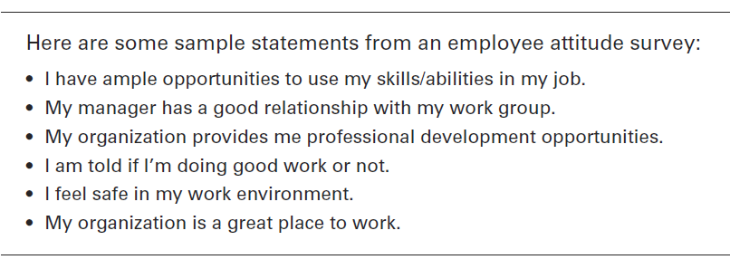
EXHIBIT 15-2 SAMPLE EMPLOYEE ATTITUDE SURVEY
Notes:
Exhibit 15-2 shows an example of an actual attitude survey.

Slide 17
PERSONALITY
Personality - the unique combination of emotional, thought, and behavioral patterns that affect how a person reacts to situations and interacts with others.
Notes:
An individual’s personality is a unique combination of emotional, thought, and behavioral patterns that affect how a person reacts to situations and interacts with others. It’s our natural way of doing things and relating to others. Personality is most often described in terms of measurable traits a person exhibits. We’re interested in looking at personality because just like attitudes, it too, affects how and why people behave the way they do.

Slide 18
MBTI®
MBTI^{® - a} popular personality-assessment instrument
Classifies individuals as exhibiting a preference in four categories:
Extraversion or introversion (E or I)
Sensing or intuition (S or N)
Thinking or feeling (T or F)
Judging or perceiving (J or P).
Notes:
One popular approach to classifying personality traits is the personality-assessment instrument known as the MBTI®. This 100-question assessment asks people how they usually act or feel in different situations. On the basis of their answers, individuals are classified as exhibiting a preference in four categories: extraversion or introversion (E or I), sensing or intuition (S or N), thinking or feeling (T or F), and judging or perceiving (J or P).

Slide 19
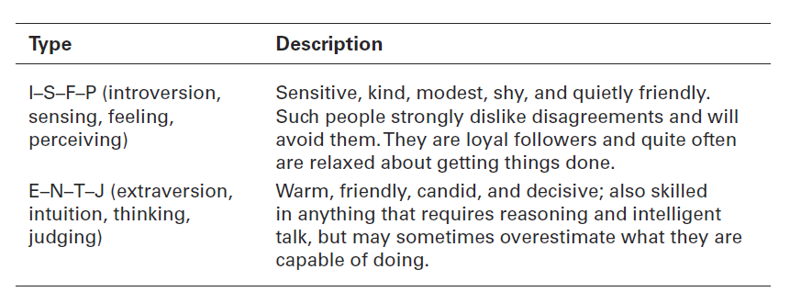
EXHIBIT 15-3 EXAMPLES OF MBTI® PERSONALITY TYPES
Notes:
Combining these preferences provides descriptions of 16 personality types, with every person identified with one of the items in each of the four pairs. Exhibit 15-3 summarizes two of them. As you can see from these descriptions, each personality type would approach work and relationships differently—neither one better than the other, just different.

Slide 20
THE BIG FIVE MODEL
Big Five Model – a personality trait model that include:
Extraversion
Agreeableness
Conscientiousness
Emotional stability
Openness to experience.
Notes:
In recent years, research has shown that five basic personality dimensions underlie all others and encompass most of the significant variation in human personality. The five personality traits in the Big Five Model are:
1. Extraversion: The degree to which someone is sociable, talkative, assertive, and
comfortable in relationships with others.
2. Agreeableness: The degree to which someone is good-natured, cooperative, and
trusting.
3. Conscientiousness: The degree to which someone is reliable, responsible,
dependable, persistent, and achievement oriented.
4. Emotional stability: The degree to which someone is calm, enthusiastic, and
secure (positive) or tense, nervous, depressed, and insecure (negative).
5. Openness to experience: The degree to which someone has a wide range of
interests and is imaginative, fascinated with novelty, artistically sensitive, and
intellectual.

Slide 21
ADDITIONAL PERSONALITY INSIGHTS
Locus of control - the degree to which people believe they are masters of their own fate.
Machiavellianism - a measure of the degree to which people are pragmatic, maintain emotional distance, and believe that ends justify means.
Notes:
Some people believe they control their own fate. Others see themselves as pawns, believing that what happens to them in their lives is due to
luck or chance. The locus of control in the first case is internal; these people believe they control their own destiny. The locus of control in the second case is external; these people believe their lives are controlled by outside forces.
Another characteristic is called Machiavellianism (Mach), named after Niccolo Machiavelli, who wrote in the sixteenth century on how to
gain and manipulate power. An individual high in Machiavellianism is pragmatic, maintains emotional distance, and believes that ends can justify means.

Slide 22
ADDITIONAL PERSONALITY INSIGHTS (CONT.)
Self-esteem - an individual’s degree of like or dislike for him/herself.
Self-monitoring - a personality trait that measures the ability to adjust behavior to external situational factors.
Notes:
People differ in the degree to which they like or dislike themselves, a trait called self-esteem. Research on self-esteem (SE) offers some interesting behavioral insights. For example, self-esteem is directly related to expectations for success. High SEs believe they possess the ability they need to succeed at work. Individuals with high SEs will take more risks in job selection and are more likely to choose unconventional jobs than people with low SEs.
That natural ability to “click” with other people may play a significant role in determining career success and is another personality
trait called self-monitoring, which refers to the ability to adjust behavior to external, situational factors. Individuals high in self-monitoring show considerable adaptability in adjusting their behavior. They’re highly sensitive to external cues and can behave differently in different situations.

Slide 23
OTHER PERSONALITY TRAITS
Proactive personality - a trait belonging to people who identify opportunities, show initiative, take action, and persevere until meaningful change occurs.
Resilience - an individual’s ability to overcome challenges and turn them into opportunities
Notes:
Another interesting trait that’s been studied extensively is t he proactive personality, which describes people who identify opportunities, show initiative, take action, and persevere until meaningful change occurs. Not surprisingly, research has shown that proactives have many desirable behaviors that organizations want.
Finally, the economic recession has prompted a reexamination of resilience, an individual’s ability to overcome challenges and turn them into opportunities. A recent study by a global consulting firm showed that it is a key factor in keeping a job: A resilient person is likely to be more adaptable, flexible, and goal-focused.

Slide 24
EMOTIONS AND EMOTIONAL INTELLIGENCE
Emotions - intense feelings that are directed at someone or something.
Emotional Intelligence (EI) - the ability to notice and to manage emotional cues and information.
Notes:
How we respond emotionally and how we deal with our emotions are typically functions of our personality. Emotions are intense feelings directed at someone or something. They’re object-specific; that is, emotions are reactions to an object.
One area of emotions research with interesting insights into personality is emotional intelligence (EI), the ability to notice and to manage emotional cues and information.

Slide 25
FIVE DIMENSIONS OF EMOTIONAL INTELLIGENCE (EI)
Emotional Intelligence (EI) is composed of five dimensions:
Self-awareness: The ability to be aware of what you’re feeling.
Self-management: The ability to manage one’s own emotions and impulses.
Self-motivation: The ability to persist in the face of setbacks and failures.
Notes:
Emotional Intelligence is composed of five dimensions:
Self-awareness: The ability to be aware of what you’re feeling.
Self-management: The ability to manage one’s own emotions and impulses.
Self-motivation: The ability to persist in the face of setbacks and failures.

Slide 26
FIVE DIMENSIONS OF EMOTIONAL INTELLIGENCE (EI) (CONT.)
Empathy: The ability to sense how others are feeling.
Social skills: The ability to handle the emotions of others.
Notes:
The last two dimensions of EI are:
Empathy: The ability to sense how others are feeling.
Social skills: The ability to handle the emotions of others.

Slide 27
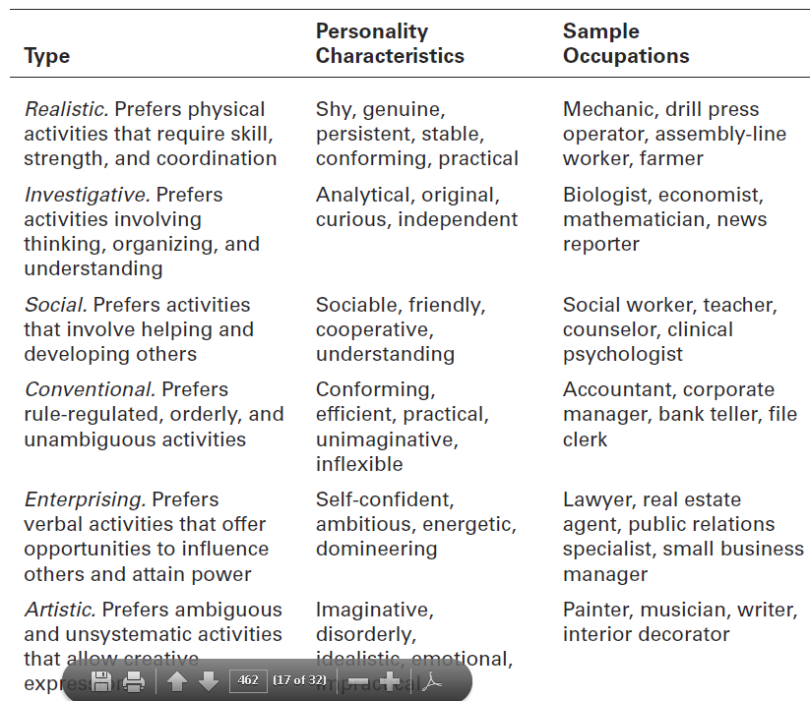
EXHIBIT 15-4 HOLLAND’S PERSONALITY–JOB FIT
Notes:
The best-documented personality-job fit theory was developed by psychologist John Holland, who identified six basic personality types. His theory states that an employee’s satisfaction with his or her job, as well as his or her likelihood of leaving that job, depends on the degree to which the individual’s personality matches the job environment. Exhibit 15-4 describes the six types, their personality characteristics, and examples of suitable occupations for each.

Slide 28
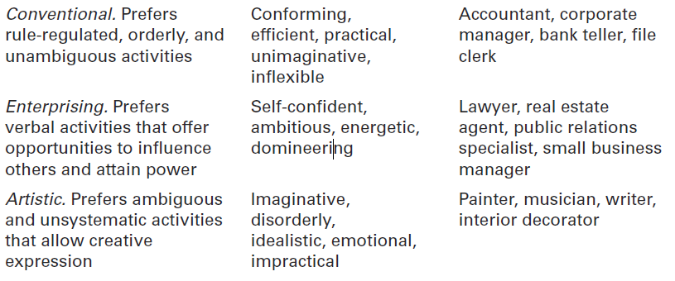
EXHIBIT 15-4 HOLLAND’S PERSONALITY–JOB FIT (CONT.)

Slide 29
PERCEPTION
Perception - a process by which we give meaning to our environment by organizing and interpreting sensory impressions.
A number of factors act to shape and sometimes distort perception including:
Perceiver
Target
Situation
Notes:
Perception is a process by which we give meaning to our environment by organizing and interpreting sensory impressions.
Research on perception consistently demonstrates that individuals may look at the same thing yet perceive it differently. One manager, for instance, can interpret the fact that her assistant regularly takes several days to make important decisions as evidence that the assistant is slow, disorganized, and afraid to make decisions. Another manager with the same assistant might interpret the same tendency as evidence that the assistant is thoughtful, thorough, and deliberate. The first manager would probably evaluate her assistant negatively; the second manager would probably evaluate the person positively. The point is that none of us sees reality. We interpret what we see and call it reality. And, of course, as the example shows, we behave according to our perceptions.

Slide 30
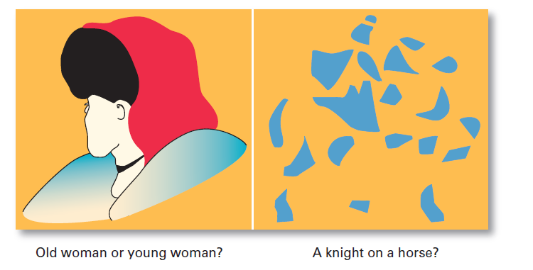
EXHIBIT 15-5 WHAT DO YOU SEE?
Notes:
The characteristics of the target being observed can also affect what’s perceived. Loud people are more likely than quiet people to be noticed in a group as are extremely attractive or unattractive individuals. The relationship of a target to its background also influences perception, as does our tendency to group close things and similar things together. You can experience these tendencies by looking at the visual perception examples shown in Exhibit 15-5. Notice how what you see changes as you look differently at each one.

Slide 31
ATTRIBUTION THEORY
Attribution Theory - how the actions of individuals are perceived by others depends on what meaning (causation) we attribute to a given behavior.
Attribution depends on three factors: distinctiveness, consensus, and consistency.
Notes:
Attribution theory was developed to explain how we judge people differently depending on what meaning we attribute to a given behavior. Basically, the theory suggests that when we observe an individual’s behavior, we attempt to determine whether it was internally or externally caused. Internally caused behaviors are those believed to be under the personal control of the individual. Externally caused behavior results from outside factors; that is, the person is forced into the behavior by the situation. That determination, however, depends on three factors: distinctiveness, consensus, and consistency.

Slide 32
ATTRIBUTION THEORY (CONT.)
Fundamental attribution error - the tendency to underestimate the influence of external factors and to overestimate the influence of internal or personal factors.
Self-serving bias - the tendency of individuals to attribute their successes to internal factors while blaming personal failures on external factors.
Notes:
One interesting finding from attribution theory is that errors or biases distort our attributions. For instance, substantial evidence supports the fact that when we make judgments about the behavior of other people, we have a tendency to underestimate the influence of external factors and to overestimate the influence of internal or personal factors. This tendency is called the fundamental attribution error and can explain why a sales manager may attribute the poor performance of her sales representative to laziness rather than to the innovative product line introduced by a competitor.
This tendency is called the self-serving bias and suggests that feedback provided to employees in performance reviews will be distorted by them depending on whether it’s positive or negative.

Slide 33
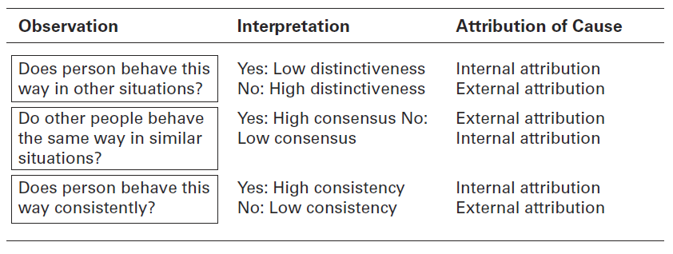
EXHIBIT 15-6 ATTRIBUTION THEORY
Notes:
Exhibit 15-6 summarizes the key elements of attribution theory.

Slide 34
SHORTCUTS USED IN JUDGING OTHERS
Assumed similarity - the assumption that others are like oneself.
Stereotyping - judging a person on the basis of one’s perception of a group to which he or she belongs.
Halo effect - a general impression of an individual based on a single characteristic.
Notes:
It’s easy to judge others if we assume they’re similar to us. In assumed similarity, or the “like me” effect, the observer’s perception of others is influenced more by the observer’s own characteristics than by those of the person observed.
When we judge someone on the basis of our perception of a group he or she is part of, we’re using the shortcut called stereotyping. For instance, “Married people are more stable employees than single persons” is an example of stereotyping.
When we form a general impression about a person on the basis of a single characteristic, such as intelligence, sociability, or appearance, we’re influenced by the halo effect.

Slide 35
LEARNING
Learning - any relatively permanent change in behavior that occurs as a result of experience.
Two theories of learning:
Operant conditioning
Social learning
Notes:
Learning occurs all the time as we continuously learn from our experiences. A workable definition of learning is any relatively permanent change in behavior that occurs as a result of experience. Two learning theories help us understand how and why individual behavior occurs.

Slide 36
OPERANT CONDITIONING
Operant conditioning - a theory of learning that says behavior is a function of its consequences
Behaviors are learned by making rewards contingent to behaviors.
Behavior that is rewarded (positively reinforced) is likely to be repeated.
Behavior that is punished or ignored is less likely to be repeated.
Notes:
Operant conditioning argues that behavior is a function of its consequences. People learn to behave to get something they want or to avoid something they don’t want. Operant behavior is voluntary or learned behavior, not reflexive or unlearned behavior. The tendency to repeat learned behavior is influenced by reinforcement or lack of reinforcement that happens as a result of the behavior. Reinforcement strengthens a behavior and increases the likelihood that it will be repeated. Lack of reinforcement weakens a behavior and lessens the likelihood that it will be repeated.

Slide 37
SOCIAL LEARNING
Social learning theory - a theory of learning that says people can learn through observation and direct experience.
The influence that these models have on an individual is determined by four processes:
Attentional processes
Retention processes
Motor reproduction processes
Reinforcement processes
Notes:
Much of what we have learned comes from watching others (models)— parents, teachers, peers, television and movie actors, managers, and so forth. This view that we can learn both through observation and direct experience is called social learning theory. The influence of others is central to the social learning viewpoint. The amount of influence these models have on an individual is determined by four processes:
Attentional processes. People learn from a model when they recognize and pay attention to its critical features. We’re most influenced by models who are attractive, repeatedly available, thought to be important, or seen as similar to us.
Retention processes. A model’s influence will depend on how well the individual remembers the model’s action, even after the model is no longer readily available.
Motor reproduction processes. After a person has seen a new behavior by observing the model, the watching must become doing. This process then demonstrates that the individual can actually do the modeled activities.
4. Reinforcement processes. Individuals will be motivated to exhibit the modeled behavior if positive incentives or rewards are provided. Behaviors that are reinforced will be given more attention, learned better, and performed more often.

Slide 38
SHAPING: A MANAGERIAL TOOL
Shaping behavior - the process of guiding learning in graduated steps using reinforcement or lack of reinforcement.
Positive reinforcement: rewarding desired behaviors
Negative reinforcement: removing an unpleasant consequence once the desired behavior is exhibited
Punishment: penalizing an undesired behavior
Extinction: eliminating a reinforcement for an undesired behavior
Notes:
Because learning takes place on the job as well as prior to it, managers are concerned with how they can teach employees to behave in ways that most benefit the organization. Thus, managers will often attempt to “mold” individuals by guiding their learning in graduated steps, through a method called shaping behavior.
Four ways to shape behavior include positive reinforcement, negative reinforcement, punishment, and extinction. When a behavior is followed by something pleasant, such as praising an employee for a job well done, it’s called positive reinforcement. Positive reinforcement increases the likelihood that the desired behavior will be repeated. Rewarding a response by eliminating or withdrawing something unpleasant
is negative reinforcement. A manager who says, “I won’t dock your pay if you start getting to work on time” is using negative reinforcement. The desired behavior (getting to work on time) is being encouraged by the withdrawal of something unpleasant (the employee’s pay being docked). On the other hand, punishment penalizes undesirable behavior and will eliminate it. Suspending an employee for two days without pay for habitually coming to work late is an example of punishment. Finally, eliminating any reinforcement that’s maintaining a behavior is called extinction. When a behavior isn’t reinforced, it gradually disappears.

Slide 39
CONTEMPORARY ISSUES IN ORGANIZATIONAL BEHAVIOR
Managing Generational Differences in the Workplace
Gen Y: individuals born after 1978
Bring new attitudes to the workplace that reflect wide arrays of experiences and opportunities
Want to work, but don’t want work to be their life
Challenge the status quo
Have grown up with technology
Notes:
There’s no consensus about the exact timespan that Gen Y comprises, but most definitions include those individuals born from about 1982
to 1997. One thing is for sure—they’re bringing new attitudes with them to the workplace. Gen Ys have grown up with an amazing array of experiences and opportunities. And they want their work life to provide that as well. Managing Gen Y workers presents some unique challenges. Conflicts and resentment can arise over issues such as appearance, technology, and management style.

Slide 40
MANAGING NEGATIVE BEHAVIOR IN THE WORKPLACE
What can managers do to manage negative behavior in the workplace?
Screening potential employees for certain personality traits
Responding immediately and decisively to unacceptable negative behaviors
Notes:
Most managers dread having to deal with difficult employees. However, they can’t just ignore the problems. So, what can managers do to manage negative behavior in the workplace?
The main thing is to recognize that it’s there. Pretending that negative behavior doesn’t exist or ignoring such misbehaviors will only confuse employees about what is expected and acceptable behavior. Although some debate among researchers questions whether preventive or responsive actions to negative behaviors are more effective, in reality, both are needed. Preventing negative behaviors by carefully
screening potential employees for certain personality traits and responding immediately and decisively to unacceptable negative behaviors can go a long way toward managing negative workplace behaviors. But it’s also important to pay attention to employee attitudes, because negativity will show up there as well. As we said earlier, when employees are dissatisfied with their jobs, they will respond somehow.

Slide 41
REVIEW LEARNING OUTCOME 15.1
Identify the focus and goals of individual behavior within organizations.
Organization behavior (OB) focuses on three areas: individual behavior, group behavior, and organizational aspects.
Behaviors include productivity, absenteeism, turnover, organizational citizenship and job satisfaction.
Notes:
Just like an iceberg, it’s the hidden organizational elements (attitudes, perceptions, norms, etc.) that make understanding individual behavior so challenging. Organization behavior (OB) focuses on three areas: individual behavior, group behavior, and organizational aspects. The goals of OB are to explain, predict, and influence behavior. Employee productivity is a performance measure of both efficiency and effectiveness. Absenteeism is the failure to report to work. Turnover is the voluntary and involuntary permanent withdrawal from an organization.
Organizational citizenship behavior (OCB) is discretionary behavior that’s not part of an employee’s formal job requirements but it promotes the effective functioning of an organization. Job satisfaction is an individual’s general attitude toward his or her job. Workplace misbehavior is any intentional employee behavior that is potentially harmful to the organization or individuals within the organization.

Slide 42
REVIEW LEARNING OUTCOME 15.2
Explain the role that attitudes play in job performance.
The cognitive component refers to the beliefs, opinions, knowledge, or information held by a person.
The affective component is the emotional or feeling part of an attitude.
The behavioral component refers to an intention to behave in a certain way toward someone or something.
Notes:
The cognitive component refers to the beliefs, opinions, knowledge, or information held by a person. The affective component is the emotional or feeling part of an attitude. The behavioral component refers to an intention to behave in a certain way toward someone or something.

Slide 43
REVIEW LEARNING OUTCOME 15.2 (CONT.)
Job satisfaction refers to a person’s general attitude toward his or her job.
Job involvement is the degree to which an employee identifies with his or her job, actively participates in it, and considers his or her job performance to be important to his or her self-worth.
Notes:
Job satisfaction refers to a person’s general attitude toward his or her job. Job involvement is the degree to which an employee identifies with his or her job, actively participates in it, and considers his or her job performance to be important to his or her self-worth.

Slide 44
REVIEW LEARNING OUTCOME 15.2 (CONT.)
Organizational commitment is the degree to which an employee identifies with a particular organization and its goals and wishes to maintain membership in that organization
Job satisfaction positively influences productivity, lowers absenteeism levels, lowers turnover rates, promotes positive customer satisfaction, moderately promotes OCB, and helps minimize workplace misbehavior.
Notes:
Organizational commitment is the degree to which an employee identifies with a particular organization and its goals
and wishes to maintain membership in that organization. Employee engagement is when employees are connected to, satisfied with, and enthusiastic about their jobs.
Job satisfaction positively influences productivity, lowers absenteeism levels, lowers turnover rates, promotes positive customer satisfaction, moderately promotes OCB, and helps minimize workplace misbehavior. Individuals try to reconcile attitude and behavior inconsistencies by altering their attitudes, altering their behavior, or rationalizing the inconsistency.

Slide 45
REVIEW LEARNING OUTCOME 15.3
Describe different personality theories.
The MBTI measures four dimensions: social interaction, preference for gathering data, preference for decision making, and style of making decisions.
The Big Five Model consists of five personality traits: extraversion, agreeableness, conscientiousness, emotional stability, and openness to experience.
Notes:
The MBTI measures four dimensions: social interaction, preference for gathering data, preference for decision making, and style of making decisions. The Big Five Model consists of five personality traits: extraversion, agreeableness, conscientiousness, emotional stability, and openness to experience.

Slide 46
REVIEW LEARNING OUTCOME 15.3 (CONT.)
The five personality traits that help explain individual behavior in organizations are locus of control, Machiavellianism, self-esteem, self-monitoring, and risk-taking.
Other personality traits include Type A/Type B personalities, proactive personality, and resilience.
Notes:
The five personality traits that help explain individual behavior in organizations are locus of control, Machiavellianism, self-esteem, self-monitoring, and risk-taking. Other personality traits include Type A/Type B personalities, proactive personality, and resilience.

Slide 47
REVIEW LEARNING OUTCOME 15.4
Describe perception and factors that influence it.
Perception is how we give meaning to our environment by organizing and interpreting sensory impressions.
The fundamental attribution error is the tendency to underestimate the influence of external factors and overestimate the influence of internal factors.
Notes:
Perception is how we give meaning to our environment by organizing and interpreting sensory impressions. Because people behave according to their perceptions, managers need to understand it.
Attribution theory depends on three factors. Distinctiveness is whether an individual displays different behaviors in different situations (that is, is the behavior unusual). Consensus is whether others facing a similar situation respond in the same way. Consistency is when a person engages in behaviors regularly and consistently. Whether these three factors are high or low helps managers determine whether employee
behavior is attributed to external or internal causes.
The fundamental attribution error is the tendency to underestimate the influence of external factors and overestimate the influence of internal factors.

Slide 48
REVIEW LEARNING OUTCOME 15.4 (CONT.)
The self-serving bias is the tendency to attribute our own successes to internal factors and to put the blame for personal failure on external factors
Three shortcuts used in judging others are assumed similarity, stereotyping, and the halo effect.
Notes:
The self-serving bias is the tendency to attribute our own successes to internal factors and to put the blame for personal failure on external factors.
Three shortcuts used in judging others are assumed similarity, stereotyping, and the halo effect.

Slide 49
REVIEW LEARNING OUTCOME 15.5
Discuss learning theories and their relevance in shaping behavior.
Operant conditioning argues that behavior is a function of its consequences.
Social learning theory says that individuals learn by observing what happens to other people
Managers can shape behavior by using positive reinforcement, negative reinforcement punishment, or extinction
Notes:
Operant conditioning argues that behavior is a function of its consequences. Managers can use it to explain, predict, and influence behavior.
Social learning theory says that individuals learn by observing what happens to other people and by directly experiencing something.
Managers can shape behavior by using positive reinforcement (reinforcing a desired behavior by giving something pleasant), negative reinforcement (reinforcing a desired response by withdrawing something unpleasant), punishment (eliminating undesirable behavior by applying penalties), or extinction (not reinforcing a behavior to eliminate it).

Slide 50
REVIEW LEARNING OUTCOME 15.6
Discuss contemporary issues in organizational behavior.
The challenge of managing Gen Y workers is that they bring new attitudes to the workplace.
Workplace misbehavior can be dealt with by recognizing that it’s there; carefully screening potential employees for possible negative tendencies, and by paying attention to employee attitudes
Notes:
The challenge of managing Gen Y workers is that they bring new attitudes to the workplace. The main challenges are over issues such as appearance, technology, and management style. Workplace misbehavior can be dealt with by recognizing that it’s there; carefully
screening potential employees for possible negative tendencies; and most importantly, by paying attention to employee attitudes through surveys about job satisfaction and dissatisfaction.

Slide 51

ANY QUESTION?

Slide 52

END OF LESSON

